Slide 1
Image Management

Slide 2
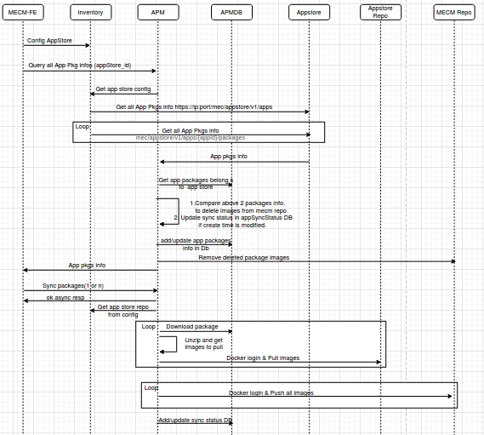
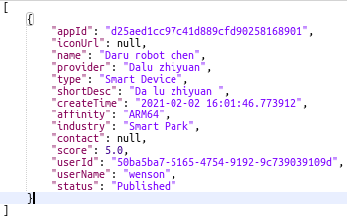

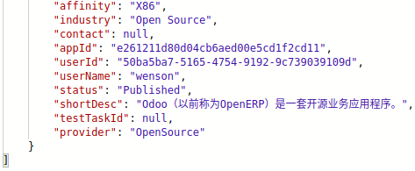
Flow Diagram
App Store get response
GET: https://119.8.63.144:30099/mec/appstore/v1/apps
GET: https://119.8.63.144:30099/mec/appstore/v1/apps/e261211d80d04cb6aed00e5cd1f2cd11/packages
GET: https://119.8.63.144:30099/mec/appstore/v1/apps/e261211d80d04cb6aed00e5cd1f2cd11/packages/b5a6ca9b8f85477bba2cd66fd79d5f98
GET: https://119.8.63.144:30099/mec/appstore/v1/apps/{appId}/packages/{packageId}/action/download

Slide 3
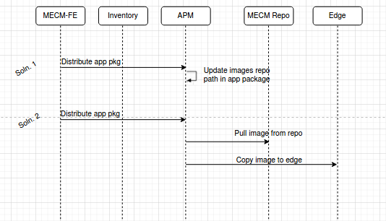

Flow Diagram
During app Instantiation docker images will be pulled from MECM repo.
In Edge, docker login to MECM repo is must prior to app instantiation, this should be handled as part of edgegallery deployment ?
Stretch goal
Not tried this soln.

Slide 4
Method | API | RequestBody | Response
POST | /inventory/v1/appstores | AppStoreDto | ok/error
PUT | /inventory/v1/appstores/{appstoreId} | AppStoreDto | ok/error
GET | /inventory/v1/appstores | none | AppStoreDtos
DELETE | /inventory/v1/appstores/{appstoreId} | none | ok/error
GET | /inventory/v1/appstores/{appstoreId} | none | AppStoreDtos
DELETE | /inventory/v1/appstores | none | ok/error
GET | apm/v1/apppkginfos/appstores/{appstoreId} | none | AppPkgInfos
POST | apm/v1/syncapppkgs | AppPkgsSync | ok/error
GET | apm/v1/syncapppkgs/status?packageIds= | none | AppPkgsSyncStatus

Slide 5
public final class AppPkgInfos {
private String packageId;
private String size;
private String createTime;
private String name;
private String version;
private String type;
private String affinity;
private String industry;
private String contact;
private String appId;
private String userId;
private String userName;
private String status;
private String shortDesc;
private String testTaskId;
private String provider;
}
public final class AppStoreDtos {
private List<AppStoreDto> appStoreDto;
}
public final class AppPkgsSync {
private String appstoreIp;
private String packageId;
private String appId;
}
public final class AppStoreDto {
private String appstoreIp;
private String appstorePort;
private String appStoreRepoUserName;
private String appStoreRepoPassword;
private String appStoreRepoURL;
}
public final class AppPkgsSyncStatus {
private String packageId;
private String appId;
private String status;
}

Slide 6
Open Questions

Slide 7
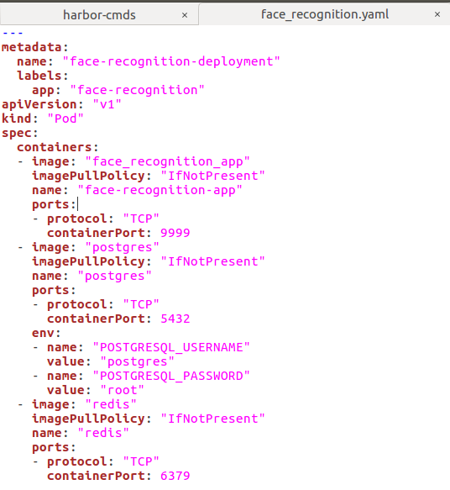
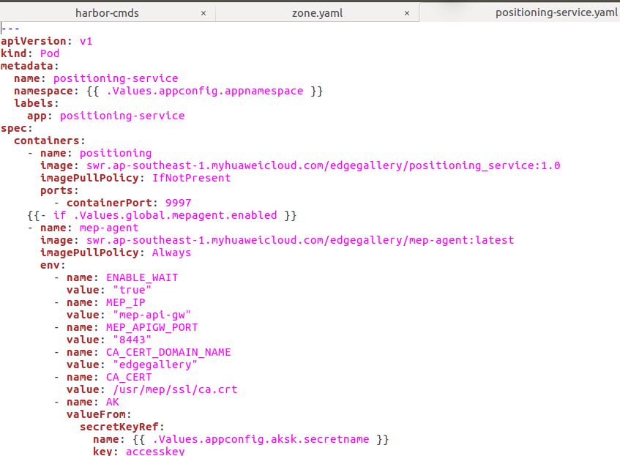
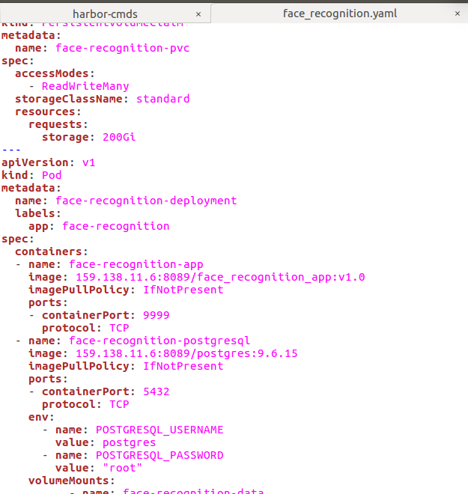
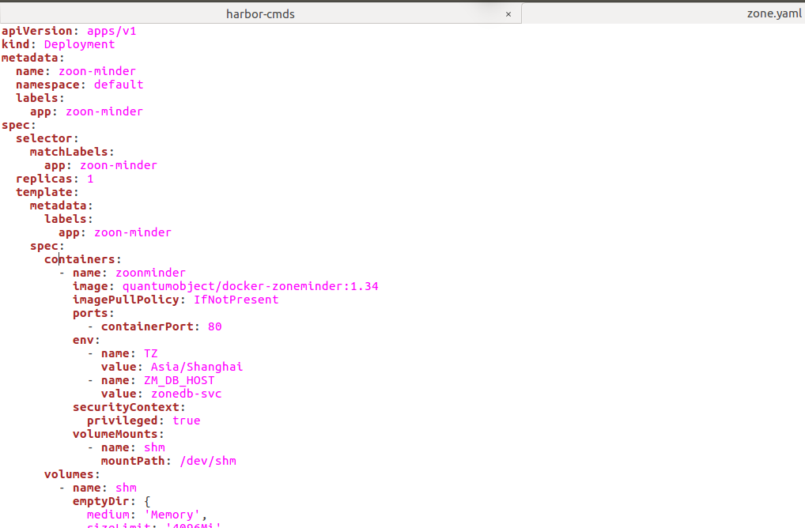
Can this be standardised to provide image name as part of values.yaml ?

Slide 8
2. Delete image in repo scenario:
How to delete docker images in MECM repo when image is used by some other application package
Possible soln: maintain count for docker image used by application packages.
3. mechanism to store app store repo password in DB:
How to get master key used to encrypt/decrypt app store repo password
4. mechanism to store MECM repo password in APM
APM communicate with MECM repo, how to get masterkey and password and how to store ?
5. Edge will pull docker images from MECM repo during instantiation, Edge docker should be logged in to MECM repo prior to app instantiation, this is done as part of edgegallery deployment using deployment scripts ?

Slide 9
Thank you

Slide 10
BackUp Slides

Slide 11
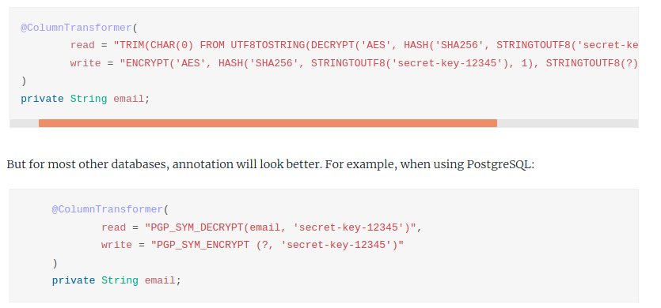
https://medium.com/faun/spring-boot-jpa-data-encryption-a8e7cacfa8e8
https://sultanov.dev/blog/database-column-level-encryption-with-spring-data-jpa/
https://sunitkatkar.blogspot.com/2018/04/spring-boot-2-generic-jpa-converter-to.html
https://vladmihalcea.com/how-to-encrypt-and-decrypt-data-with-hibernate/
https://www.baeldung.com/spring-boot-jasypt
https://www.geeksforgeeks.org/how-to-encrypt-passwords-in-a-spring-boot-project-using-jasypt/

